Slide 1


FACIAL EMOTION RECOGNITION USING ML ALGORITHMS
Date: 22 April 2021
V.V.S.S.RAMYA : 17WH1A0501
SK.AFIFARESHMA : 17WH1A0535
AFRAH SAMREEN : 17WH1A0526
Internal Guide: Mr. U.CHANDRASEKHAR
Designation: Associate Professor
Department of Computer Science & Engineering
BVRIT HYDERABAD College of Engineering for Women

Slide 2
Abstract
Why Should I Study this course?
PROJECT OVERVIEW : Facial expression for emotion detection has always been a challenging task in achieving through computer algorithms. In the field of Artificial Intelligence, Facial Emotion Recognition (FER) is an active research area, with several recent studies. With the recent advancement in computer vision and machine learning, it is possible to detect emotion from images. In this project we propose a technique called facial emotion recognition using convolutional neural networks.
Examples
BVRIT HYDERABAD College of Engineering for Women

Slide 3
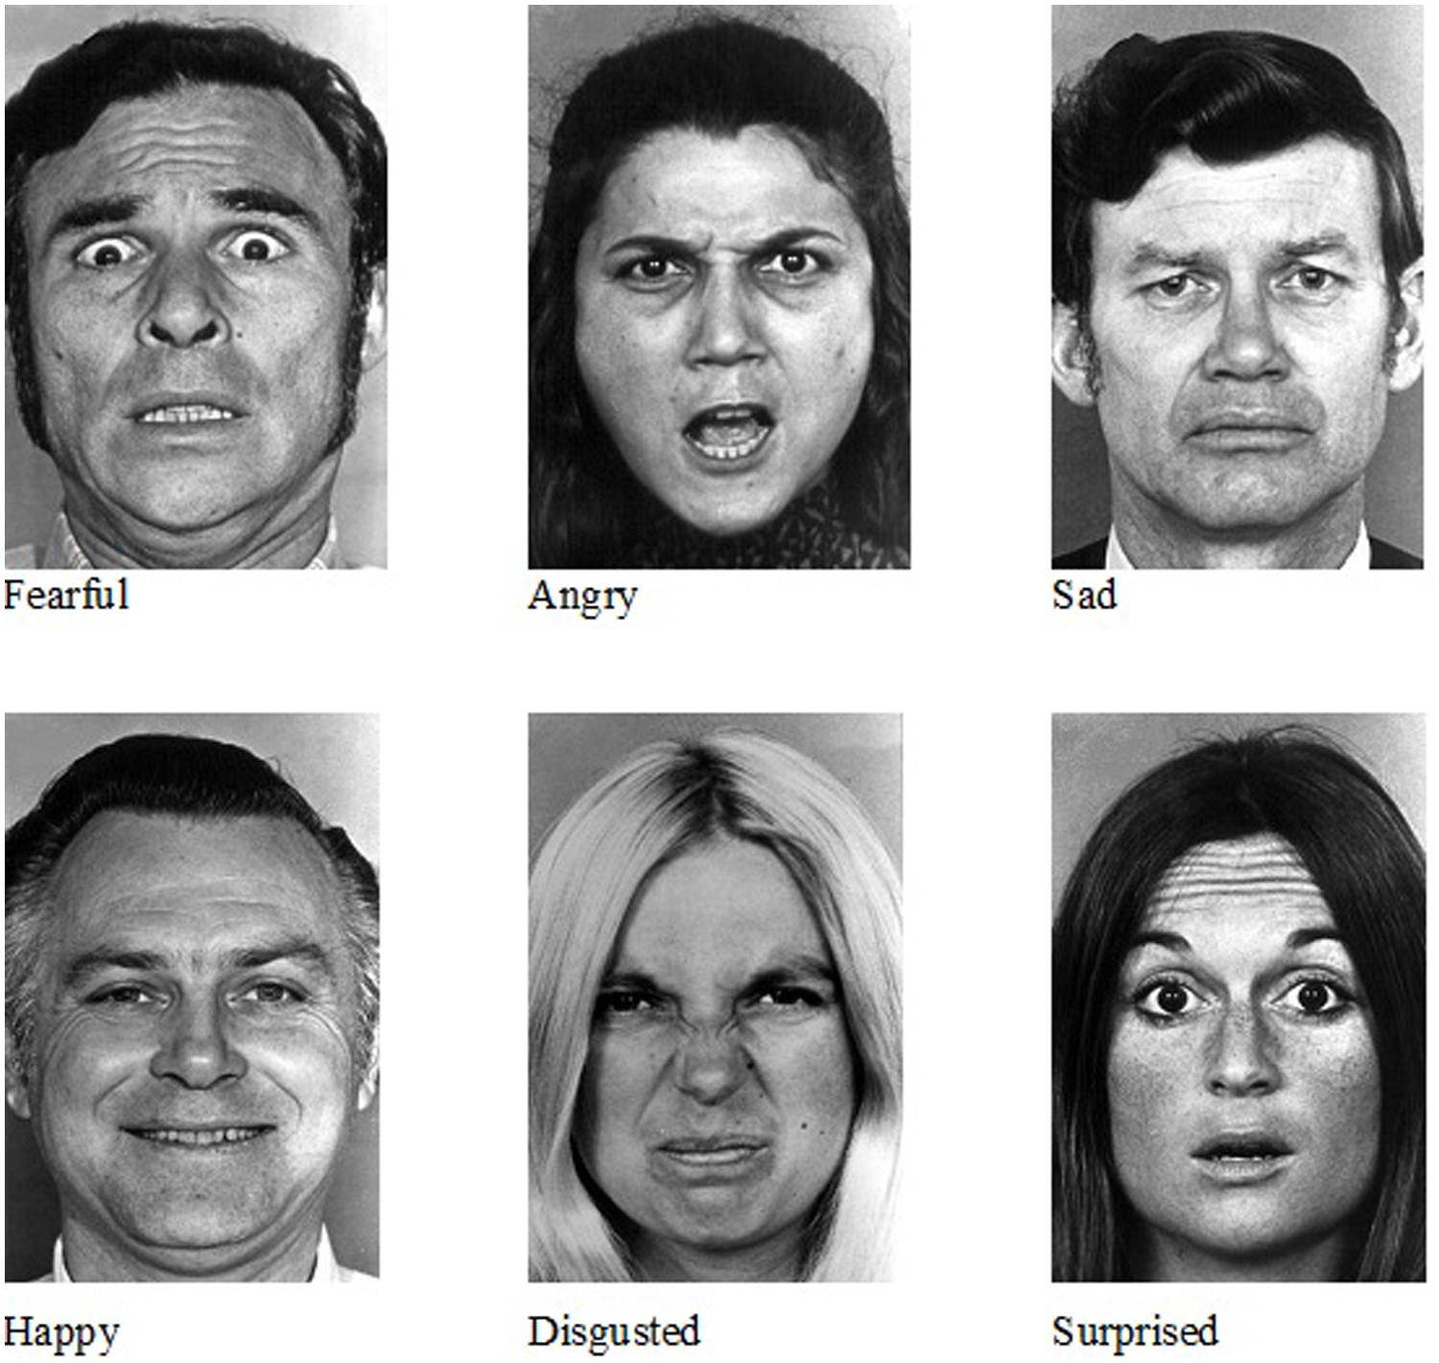
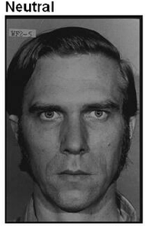
Dataset
Dataset Description:
The dataset consist of more than 35,887 images of different facial emotions of humans.
The different emotions are
Happy
Sad
Disgusted
Surprised
Fearful
Angry
Neutral
BVRIT HYDERABAD College of Engineering for Women

Slide 4
Architecture
Data Acquisition
Happy
Sad
Data Preprocessing
Surprise
Model Creation
Anger
Testing and Accuracy
Fear
Input image
Disgust
Classification
Neutral

Slide 5
Technology Stack
Machine Learning
Python Programming Language
Google Colab
Required Packages :
numpy
pandas
keras
Cv2
Sklearn
Matplotlib

Slide 6
System Specifications
Hardware : Processor - Intel Core i5
Memory - 8GB
Storage - 1TB
Software : Python
OS-Windows 10
BVRIT HYDERABAD College of Engineering for Women

Slide 7
Timeline
Review 0 | Identifying Scope and Applications Requirements & Speciﬁcations
Review 1 | Data Acquisition Data Preprocessing
Review 2 | Model Creation Testing and Accuracy
Review 3 | Classification
 | Report of the Project

Slide 8
References
Base Paper :
Shichuan Du, Yong Tao, and Aleix M. Martinez1 Department of Electrical and Computer Engineering, and Center for Cognitive and Brain Sciences, The Ohio State University, Columbus, OH 43210 Edited by David J. Heeger, New York University, New York, NY, and approved February 28, 2014
Reference Paper :
https://www.researchgate.net/publication/343443531_Facial_Emotion_Recognition_A_Brief_Review
BVRIT HYDERABAD College of Engineering for Women

Slide 9
Thank you
BVRIT HYDERABAD College of Engineering for Women

